Slide 1
Attention-based Model
Hung-yi Lee
Notes:
http://www.thespermwhale.com/jaseweston/ram/

Slide 2
Attention-based Model
Information from the sensors (e.g. eyes, ears)
When the input is a very long sequence or an image
Sensory Memory
Pay attention on partial of the input object each time
Attention
Working Memory
Encode
Retrieval
Long-term Memory

Slide 3
Attention-based Model
Information from the sensors (e.g. eyes, ears)
When the input is a very long sequence or an image
Sensory Memory
Pay attention on partial of the input object each time
Attention
Working Memory
In RNN/LSTM, larger memory implies more parameters
Encode
Retrieval
Increasing memory size will not increasing parameters
Long-term Memory

Slide 4
Attention on Sensory Information
Information from the sensors (e.g. eyes, ears)
Sensory Memory
Attention
Working Memory
Encode
Retrieval
Long-term Memory
Notes:
http://www.thespermwhale.com/jaseweston/ram/

Slide 5
Machine Translation
Sequence to sequence learning: Both input and output are both sequences with different lengths.
E.g. 機器學習→machine learning
Information of the whole sentences
machine
learning
===
機
器
學
習
Notes:
Not state-of-the-art

Slide 6
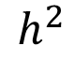
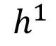
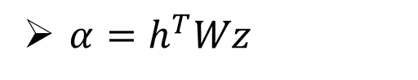
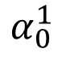
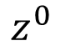
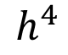
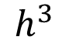
Machine Translation
Attention-based model
match
What is ?
$$α_{0}^{1}$$
Cosine similarity of z and h
match
$$z^{0}$$
Small NN whose input is z and h, output a scalar
$$h^{1}$$
$$h^{2}$$
$$h^{3}$$
$$h^{4}$$
$α=h^{T}Wz$
How to learn the parameters?
機
器
學
習
Notes:
Word vector

Slide 7
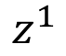
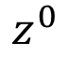
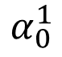
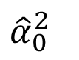
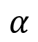
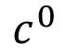
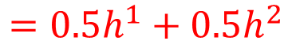
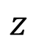
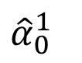
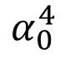
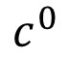
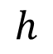
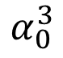
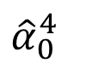
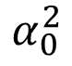
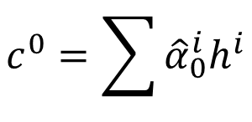
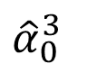
Machine Translation
How to learn the parameters?
Attention-based model
$$α$$
machine
$$c^{0}$$
match
0.5
$${\hat{α}}_{0}^{1}$$
0.5
$${\hat{α}}_{0}^{2}$$
0.0
$${\hat{α}}_{0}^{3}$$
0.0
$${\hat{α}}_{0}^{4}$$
$$z$$
$$z^{0}$$
$$z^{1}$$
$$h$$
softmax
$$α_{0}^{1}$$
$$α_{0}^{2}$$
$$α_{0}^{3}$$
$$α_{0}^{4}$$
$$c^{0}$$
As RNN input
$$h^{1}$$
$$h^{2}$$
$$h^{3}$$
$$h^{4}$$
$$c^{0}=\sum{{\hat{α}}_{0}^{i}h^{i}}$$
機
器
學
習
$$=0.5h^{1}+0.5h^{2}$$
Notes:
Word vector

Slide 8
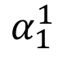
Machine Translation
Attention-based model
machine
$$α_{1}^{1}$$
match
$$z^{0}$$
$$z^{1}$$
$$c^{0}$$
$$h^{1}$$
$$h^{2}$$
$$h^{3}$$
$$h^{4}$$
機
器
學
習
Notes:
Word vector

Slide 9
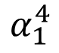
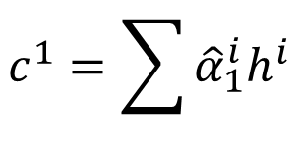
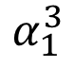
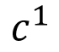
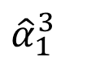
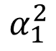
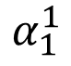
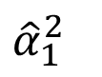
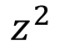
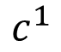
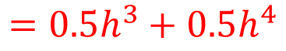
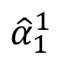
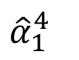
Machine Translation
Attention-based model
machine
learning
$$c^{1}$$
0.0
$${\hat{α}}_{1}^{1}$$
0.0
$${\hat{α}}_{1}^{2}$$
0.5
$${\hat{α}}_{1}^{3}$$
0.5
$${\hat{α}}_{1}^{4}$$
$$z^{0}$$
$$z^{1}$$
$$z^{2}$$
softmax
$$α_{1}^{1}$$
$$α_{1}^{2}$$
$$α_{1}^{3}$$
$$α_{1}^{4}$$
$$c^{0}$$
$$c^{1}$$
$$h^{1}$$
$$h^{2}$$
$$h^{3}$$
$$h^{4}$$
$$c^{1}=\sum{{\hat{α}}_{1}^{i}h^{i}}$$
機
器
學
習
$$=0.5h^{3}+0.5h^{4}$$
Notes:
Word vector

Slide 10
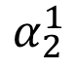
Machine Translation
Attention-based model
machine
learning
……
$$α_{2}^{1}$$
……
match
$$z^{0}$$
$$z^{1}$$
$$z^{2}$$
$$c^{0}$$
$$c^{1}$$
……
$$h^{1}$$
$$h^{2}$$
$$h^{3}$$
$$h^{4}$$
The same process repeat until generating
機
器
學
習
======
Notes:
Word vector

Slide 11
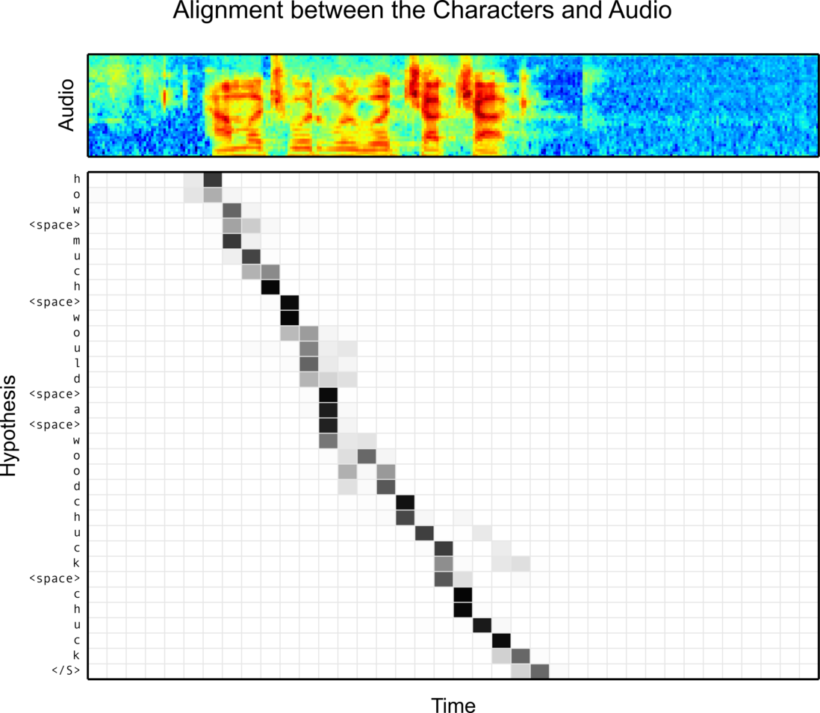
Speech Recognition
William Chan, Navdeep Jaitly, Quoc V. Le, Oriol Vinyals, “Listen, Attend and Spell”, arXiv’15
Notes:
土撥鼠
撥

Slide 12
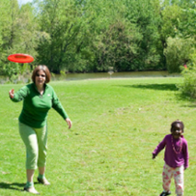
Image Caption Generation
Input an image, but output a sequence of words
A vector for whole image
(斷)
a
woman
is
===
CNN
……
Input image
Notes:
A woman is throwing a Frisbee in a part.

Slide 13
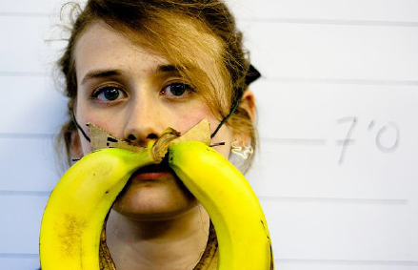
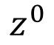
Image Caption Generation
A vector for each region
match
$$z^{0}$$
0.7
CNN
filter
filter
filter
filter
filter
filter
filter
filter
filter
filter
filter
filter

Slide 14
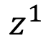
Image Caption Generation
Word 1
A vector for each region
$$z^{0}$$
$$z^{1}$$
CNN
filter
filter
filter
weighted sum
filter
filter
filter
0.7
0.1
0.1
0.1
0.0
0.0
filter
filter
filter
filter
filter
filter

Slide 15
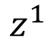
Image Caption Generation
Word 1
Word 2
A vector for each region
$$z^{0}$$
$$z^{1}$$
$$z^{1}$$
weighted sum
CNN
filter
filter
filter
filter
filter
filter
0.0
0.8
0.2
0.0
0.0
0.0
filter
filter
filter
filter
filter
filter

Slide 16
Image Caption Generation
Good captions
Notes:
Caption generation story like
How to do story like !!!!!!!!!!!!!!!!!!
http://www.cs.toronto.edu/~mbweb/
https://github.com/ryankiros/neural-storyteller

Slide 17
Image Caption Generation
Bad captions
Notes:
滑板相關詞
skateboarding
查看全部
skateboard
¹ Dr.eye譯典通
KK [ˋsket͵bord] DJ [ˋskeitbɔ:d]

Slide 18
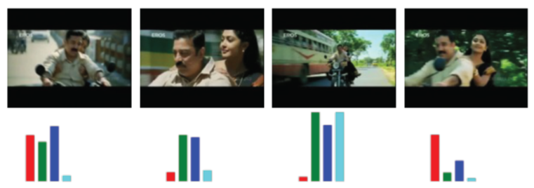
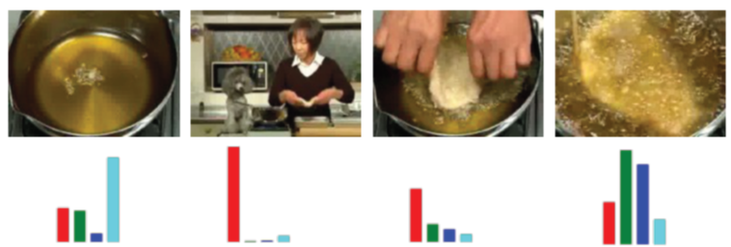

Notes:
Another application is summarization

Slide 19
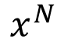
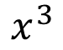
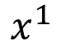






Reading Comprehension
Answer
$$=\sum_{n=1}^{N}{α_{n}x^{n}}$$
DNN
Sentence to vector can be jointly trained.
Extracted Information
$$α_{1}$$
$$α_{2}$$
$$α_{3}$$
$$α_{N}$$
Document
……
$$x^{N}$$
$$x^{1}$$
$$x^{2}$$
$$x^{3}$$
Match
q
Query
vector
Please refer to the lecture on 2015/12/04
Notes:
Conventional reading comprehension
Find support sentences
Answering
Find the suppor sentence by attentione-based model
All questions is QA
VQA is the same, not describe here

Slide 20









Memory
Network
Answer
$$=\sum_{n=1}^{N}{α_{n}h^{n}}$$
Extracted Information
DNN
Jointly learned
$$h^{1}$$
$$h^{2}$$
$$h^{3}$$
……
$$h^{N}$$
Hopping
$$α_{1}$$
$$α_{2}$$
$$α_{3}$$
$$α_{N}$$
Document
……
$$x^{N}$$
$$x^{1}$$
$$x^{2}$$
$$x^{3}$$
Match
q
Query
vector
Please refer to the lecture on 2015/12/04
Notes:
Conventional reading comprehension
Find support sentences
Answering
Find the suppor sentence by attentione-based model
All questions is QA
VQA is the same, not describe here

Slide 21



Memory
Network
DNN
a
Extract information
……
……
Compute attention
Extract information
……
……
Compute attention
q

Slide 22

Memory Network
Performance of Hopping
Demo video: https://www.facebook.com/Engineering/videos/10153098860532200/

Slide 23


Special Attention: Spatial Transformers
Max Jaderberg, Karen Simonyan, Andrew Zisserman, Koray Kavukcuoglu, Spatial Transformer Networks, arXiv’15
CNN
Bad results
CNN
Good results
Jointly learned
Notes:
Max Jaderberg, Karen Simonyan, Andrew Zisserman, Koray Kavukcuoglu, Spatial Transformer Networks, arXiv’15
The attention mechanism in Spatial Transformer Networks (Jaderberg et. al. 2015) extends DRAW by allowing more complex transformations of the sampling grid
E.g. affine transformations
Can also extend to 3d sampling grids

Slide 24
Attention on Memory
Information from the sensors (e.g. eyes, ears)
Sensory Memory
Attention
Working Memory
Encode
Retrieval
Long-term Memory
Notes:
http://www.thespermwhale.com/jaseweston/ram/

Slide 25

Neural Turing Machine
von Neumann architecture
Actually, Neural Turing Machine is an advanced RNN/LSTM.
https://www.quora.com/How-does-the-Von-Neumann-architecture-provide-flexibility-for-program-development
Notes:
范紐曼型架構（英語：von Neumann architecture）
算術邏輯單元

Slide 26









Neural Turing Machine
y¹
y²
h⁰
h¹
h²
$$r^{0}=\sum{{\hat{α}}_{0}^{i}m_{0}^{i}}$$
r⁰
x¹
x²
Retrieval process
$${\hat{α}}_{0}^{1}$$
$${\hat{α}}_{0}^{2}$$
$${\hat{α}}_{0}^{3}$$
$${\hat{α}}_{0}^{4}$$
Long term memory
$$m_{0}^{1}$$
$$m_{0}^{2}$$
$$m_{0}^{3}$$
$$m_{0}^{4}$$
Notes:
What is the different

Slide 27












Neural Turing Machine
y¹
y²
h⁰
h¹
h²
$$r^{0}=\sum{{\hat{α}}_{0}^{i}m_{0}^{i}}$$
r⁰
x¹
x²
$$k_{}^{1}$$
$$e_{}^{1}$$
$$a_{}^{1}$$
$${\hat{α}}_{0}^{1}$$
$${\hat{α}}_{0}^{2}$$
$${\hat{α}}_{0}^{3}$$
$${\hat{α}}_{0}^{4}$$
$${\hat{α}}_{1}^{1}$$
$${\hat{α}}_{1}^{2}$$
$${\hat{α}}_{1}^{3}$$
$${\hat{α}}_{1}^{4}$$
softmax
$$m_{0}^{1}$$
$$m_{0}^{2}$$
$$m_{0}^{3}$$
$$m_{0}^{4}$$
$$α_{1}^{1}$$
$$α_{1}^{2}$$
$$α_{1}^{3}$$
$$α_{1}^{4}$$
(simplified)
$$α_{1}^{i}=\left(1−λ\right)α_{0}^{i}+cos\left(m_{0}^{i},k^{1}\right)$$
Notes:
What is the different

Slide 28













Neural Turing Machine
Encode process
$$m_{1}^{i}$$
$$=$$
$$m_{0}^{i}$$
$$∗$$
$$1$$
$${−\hat{α}}_{1}^{i}$$
$$e_{}^{1}$$
$${+\hat{α}}_{1}^{i}$$
$$a_{}^{1}$$
(element-wise)
$$k_{}^{1}$$
$$e_{}^{1}$$
$$a_{}^{1}$$
$${\hat{α}}_{0}^{1}$$
$${\hat{α}}_{0}^{2}$$
$${\hat{α}}_{0}^{3}$$
$${\hat{α}}_{0}^{4}$$
$${\hat{α}}_{1}^{1}$$
$${\hat{α}}_{1}^{2}$$
$${\hat{α}}_{1}^{3}$$
$${\hat{α}}_{1}^{4}$$
$$m_{0}^{1}$$
$$m_{0}^{2}$$
$$m_{0}^{3}$$
$$m_{0}^{4}$$
$$m_{1}^{1}$$
$$m_{1}^{2}$$
$$m_{1}^{3}$$
$$m_{1}^{4}$$
Notes:
What is the different

Slide 29








Neural Turing Machine
Wei Zhang, Yang Yu, Bowen Zhou, Structured Memory for Neural Turing Machines, arXiv’15
y¹
y²
h⁰
h¹
h²
r⁰
x¹
r¹
x²
$${\hat{α}}_{0}^{1}$$
$${\hat{α}}_{0}^{2}$$
$${\hat{α}}_{0}^{3}$$
$${\hat{α}}_{0}^{4}$$
$${\hat{α}}_{1}^{1}$$
$${\hat{α}}_{1}^{2}$$
$${\hat{α}}_{1}^{3}$$
$${\hat{α}}_{1}^{4}$$
$${\hat{α}}_{2}^{1}$$
$${\hat{α}}_{2}^{2}$$
$${\hat{α}}_{2}^{3}$$
$${\hat{α}}_{2}^{4}$$
$$m_{0}^{1}$$
$$m_{0}^{2}$$
$$m_{0}^{3}$$
$$m_{0}^{4}$$
$$m_{1}^{1}$$
$$m_{1}^{2}$$
$$m_{1}^{3}$$
$$m_{1}^{4}$$
$$m_{2}^{1}$$
$$m_{2}^{2}$$
$$m_{2}^{3}$$
$$m_{2}^{4}$$
Notes:
What is the different!!!!!!!!!!!!!!!!!!???????????????????????

Slide 30
Stack RNN
Armand Joulin, Tomas Mikolov, Inferring Algorithmic Patterns with Stack-Augmented Recurrent Nets, 2015
stack
y^{t}
0.7
0.2
0.1
Push, Pop, Nothing
Information to store
h^{t}
Push
X0.7
+
Pop
-1
-1
X0.2
+
x^{t}
Nothing
-1
X0.1
Notes:
Armand Joulin, Tomas Mikolov, Inferring Algorithmic Patterns with Stack-Augmented Recurrent Nets, 2015

Slide 31
Concluding Remarks
Information from the sensors (e.g. eyes, ears)
Sensory Memory
Translation
Speech Recognition
Caption Generation
Question Answering
Attention
Working Memory
Encode
Retrieval
Neural Turing Machine, Stack RNN
Long-term Memory
Notes:
Tomas version

Slide 32
Reference
End-To-End Memory Networks. S. Sukhbaatar, A. Szlam, J. Weston, R. Fergus. arXiv Pre-Print, 2015.
Neural Turing Machines. Alex Graves, Greg Wayne, Ivo Danihelka. arXiv Pre-Print, 2014
Ask Me Anything: Dynamic Memory Networks for Natural Language Processing. Kumar et al. arXiv Pre-Print, 2015
Neural Machine Translation by Jointly Learning to Align and Translate. D. Bahdanau, K. Cho, Y. Bengio; International Conference on Representation Learning 2015.
Show, Attend and Tell: Neural Image Caption Generation with Visual Attention. Kelvin Xu et. al.. arXiv Pre-Print, 2015.
Attention-Based Models for Speech Recognition. Jan Chorowski, Dzmitry Bahdanau, Dmitriy Serdyuk, Kyunghyun Cho, Yoshua Bengio. arXiv Pre-Print, 2015.
A Neural Attention Model for Abstractive Sentence Summarization. A. M. Rush, S. Chopra and J. Weston. EMNLP 2015.

Slide 33
Plan
1/8 (五) 23:59: Presentation team decided
1/13 (三) 23:59: Presentation slides deadline
1/15 (五)
上課時間：Presentation
返鄉投票
1/16 (六) : 投票
1/20 (三) 23:59: Report deadline
Notes:
大家加油吧! 痛苦就要過去了

Slide 34

Teaching Machines to Read and Comprehend, Hermann et. al. (2015)

